Slide 1

Food Scraps
CANDEV Data Challenge
Team Members: Eric Haggar
Aymen Mhamdi
Munir Aljawahari
Tamer Ibrahim

Slide 2


Our Solution
Randomly selected food companies within Canada and importing to Canada to build a dataset
Performed Web Scraping on Glassdoor and a Food Recalls Database.
Created a scoring system algorithm to flag food companies to undergo inspection

Slide 3
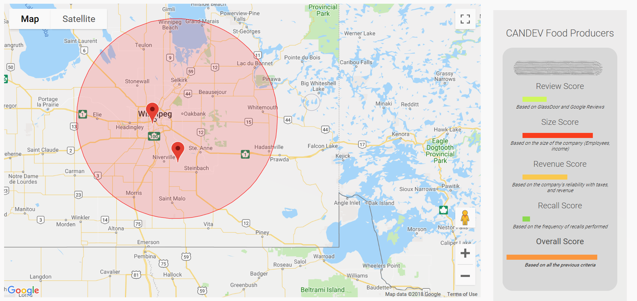
Additional Information
Displayed the companies that did not pass the scoring system on an interactive map (Google Maps).

Slide 4

Further Improvements – Optimal Solution
If access to the internal CFIA data was given, the FoodScraps team would have been able to use more complex algorithms and develop a more accurate scoring system.

Slide 5


